Slide 1

Get Personal
Sanjay Vakil, PhD

Slide 2
Overview
Intro to TripAdvisor
Intro to
Instant Personalization
The Rollercoaster +
Three equations
Notes:
In today’s online and social world, travelers share comments that are rapidly and readily accessible to the public. What someone says about your property has farther reach – and potentially longer lasting effects -- than ever before.
Review sites are the hub of travelers’ sharing activity, and a top resource when they’re forming opinions. In their June study on Social Media in Travel, PhoCusWright states that travel review sites are one of the most influential forces for travelers during the shopping process. In an MSNBC poll from October, 86% of respondents said they rely on feedback from TripAdvisor and other review sites when making travel plans.
Minding your reputation on these sites is a critical part of marketing and operations for today’s hotels.

Slide 3
Online reputation is critical
“
Travel review Web sites and hotel reviews on online travel agencies (OTAs) are among the most influential forces most frequently cited by travelers when shopping.
-PhoCusWright, Social Media in Travel, June 2010
“
Notes:
In today’s online and social world, travelers share comments that are rapidly and readily accessible to the public. What someone says about your property has farther reach – and potentially longer lasting effects -- than ever before.
Review sites are the hub of travelers’ sharing activity, and a top resource when they’re forming opinions. In their June study on Social Media in Travel, PhoCusWright states that travel review sites are one of the most influential forces for travelers during the shopping process. In an MSNBC poll from October, 86% of respondents said they rely on feedback from TripAdvisor and other review sites when making travel plans.
Minding your reputation on these sites is a critical part of marketing and operations for today’s hotels.

Slide 4
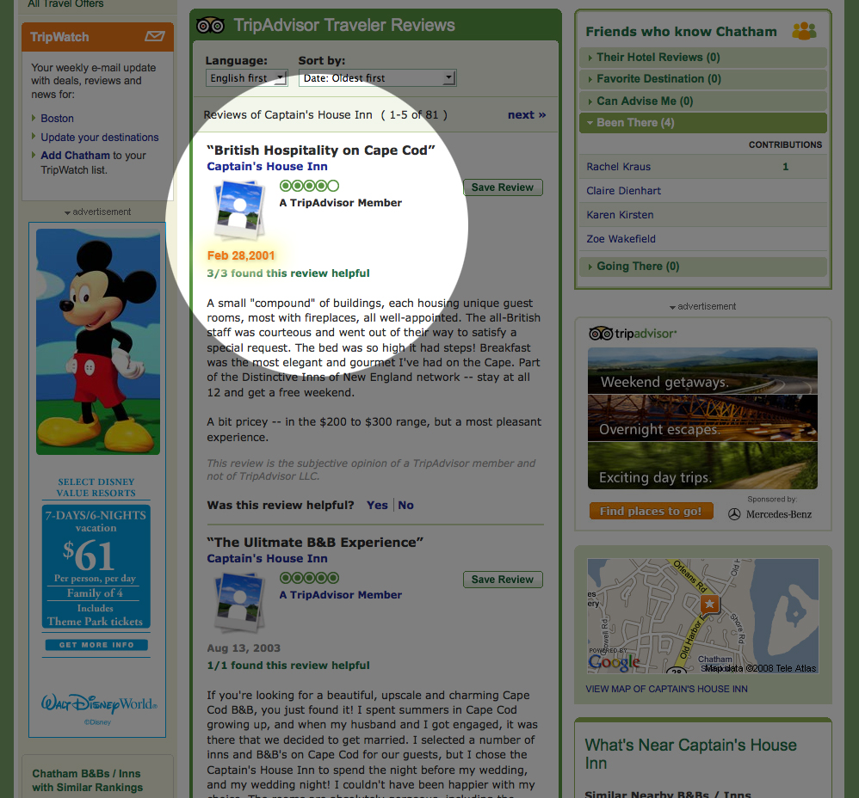
UGC Fuels and Rules
Notes:
Our very first review was published on our .com in February 2001. We were one of the early generation user-generated content sites, built almost entirely on the opinions and contributions of everyday people.

Slide 5
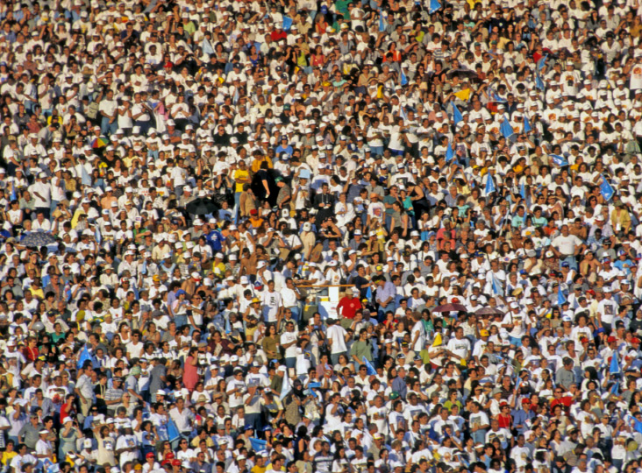
TripAdvisor Snapshot
40MM unique visitors per month
20MM highly loyal registered members
45MM++ traveler reviews and opinions
21 new contributions per minute every day
455K hotels, 92K attractions, 564K
restaurants in 71K destinations worldwide
245,000 registered owners
Notes:
I want to start with a brief update on TripAdvisor. I know that many of you are familiar with us, so I’ll focus on what’s new, and what we’ve been up to recently.
We continue to grow at a rapid pace. Our user-generated content has reached 45 million reviews and opinions, and our community now includes 20 million loyal, registered members who submit 21 new contributions every minute of every day. We have listings for more than 1 million properties in over 71,000 destinations worldwide.

Slide 6
Overview
Intro to TripAdvisor
Intro to
Instant Personalization
The Rollercoaster +
Three equations
Notes:
In today’s online and social world, travelers share comments that are rapidly and readily accessible to the public. What someone says about your property has farther reach – and potentially longer lasting effects -- than ever before.
Review sites are the hub of travelers’ sharing activity, and a top resource when they’re forming opinions. In their June study on Social Media in Travel, PhoCusWright states that travel review sites are one of the most influential forces for travelers during the shopping process. In an MSNBC poll from October, 86% of respondents said they rely on feedback from TripAdvisor and other review sites when making travel plans.
Minding your reputation on these sites is a critical part of marketing and operations for today’s hotels.

Slide 7
Instant Personalization
Invite-only Facebook program
Opt-Out, not Opt-in
  Only on .com for now
Facebook provides TripAdvisor access to
  Visitor’s profile data
  List of friends
Notes:
- Optout means that ~20% of our traffic sees this behaviour

Slide 8
The big deal
We can instantly personalize a user that has never been to TripAdvisor before

Slide 9
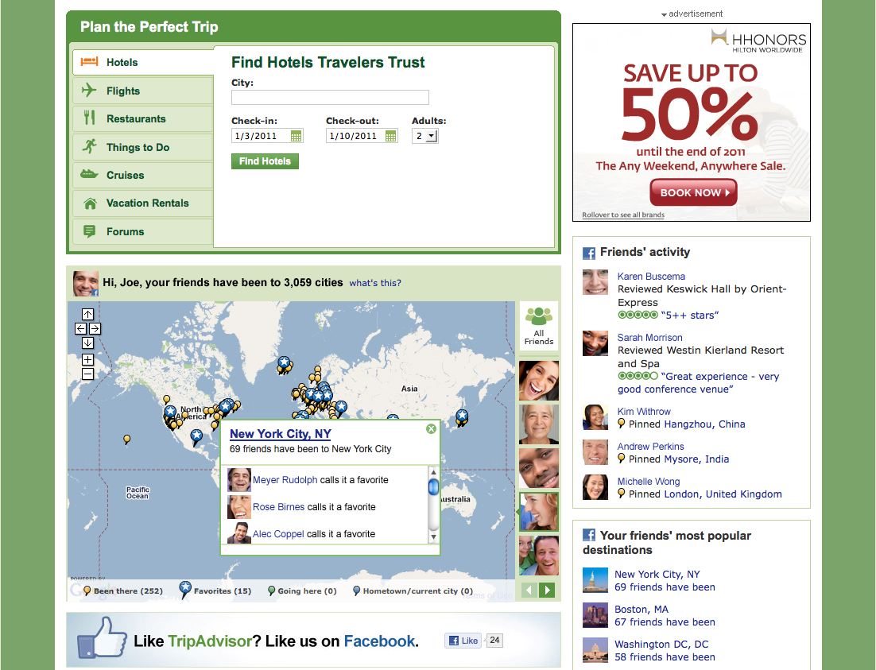
Notes:
We’ve been focused in the last year on making our content available wherever and however travelers are making plans, and social and mobile have been at the top of our list. PhoCusWright’s November U.S. Online Travel Overview confirms what we’re seeing – that social and mobile are no longer trends for the future, but are being used in every phase of trip planning now.
Social media isn’t a new focus for us, but we’ve taken it to whole level in the last few months. When Facebook opened their API platform in spring of 2007, TripAdvisor adapted one of our site features into a Facebook app called Cities I’ve Visited where users pin maps. It’s been one of the top Facebook travel apps ever since and now has 5 million monthly active users, 18 million lifetime users, and more than 1 billion pins of where travelers are going, have been, can advise their friends about, and favorite destinations. Five million new pins are added every day.
In December we announced an integration with Facebook – based in part on that Cities I’ve Visited data -- that instantly personalizes the site for each person who visits, surfacing trusted reviews from friends, most popular destinations among friends, and an interactive social map. The integration is the next step in making travel planning even more fun, relevant, and social for travelers. More than half of TripAdvisor users have a Facebook account, and we wanted to make it easier for them to find the most relevant and social content quickly and share the experience with their friends.
Now when travelers come to TripAdvisor.com, while logged into Facebook, they will see the activities their friends have shared first, helping them to make more informed decisions when planning their own trip. They can see a map on the homepage revealing where their friends have been (click to animate in arrow), to inspire them to visit a new destination (click to animate in arrow).

Slide 10
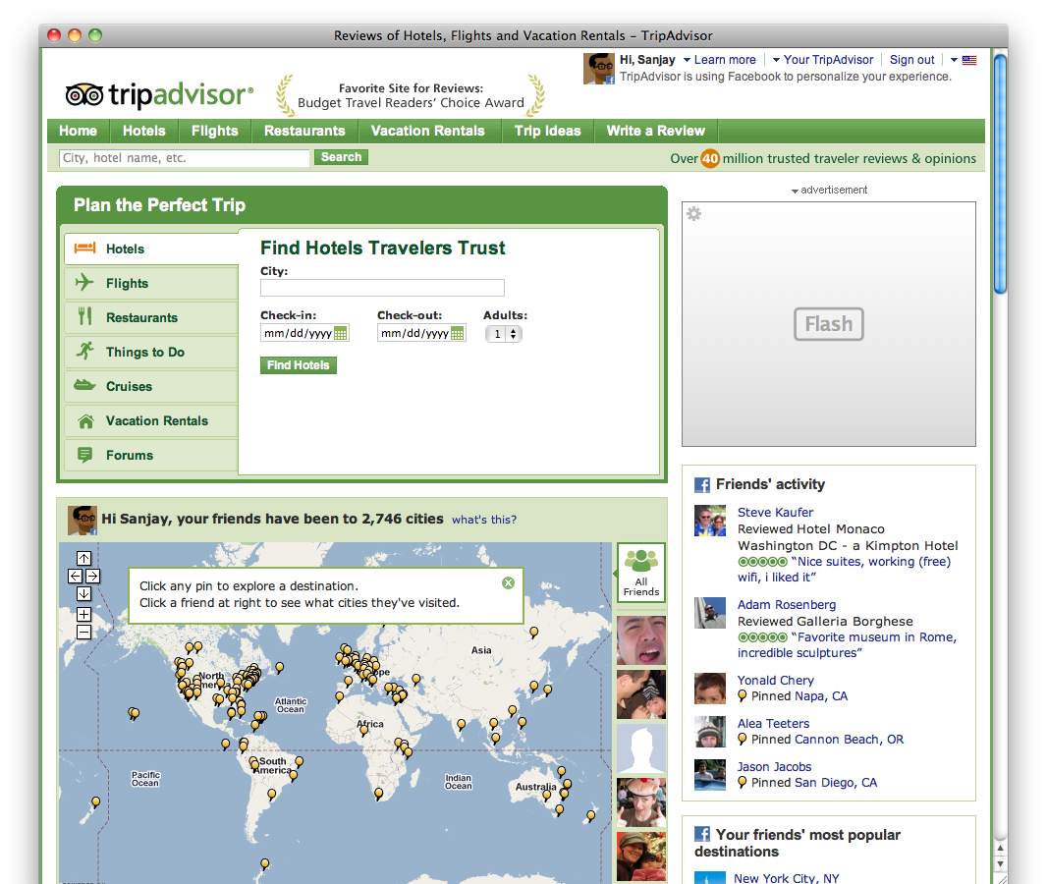

Instant Personalization: Homepage
Notes:
When a visitor shows up, we can show them their name and avatar

Slide 11
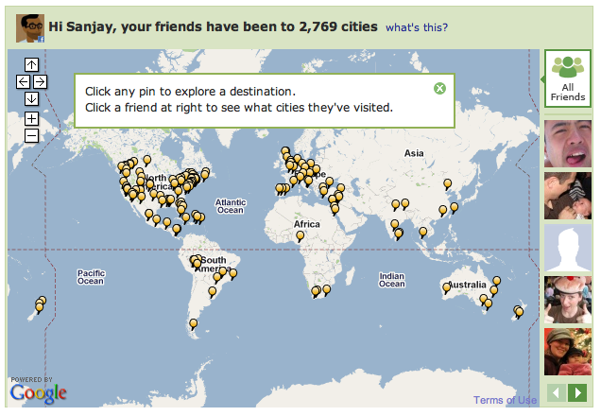
Instant Personalization: Homepage
Notes:
A map showing all of the cities their friends have visited.

Slide 12
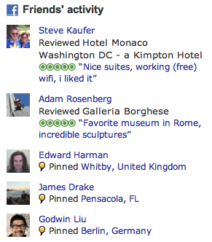
Instant Personalization: Homepage
Notes:
And can identify both reviews done by their friends and other sort of recent activity

Slide 13
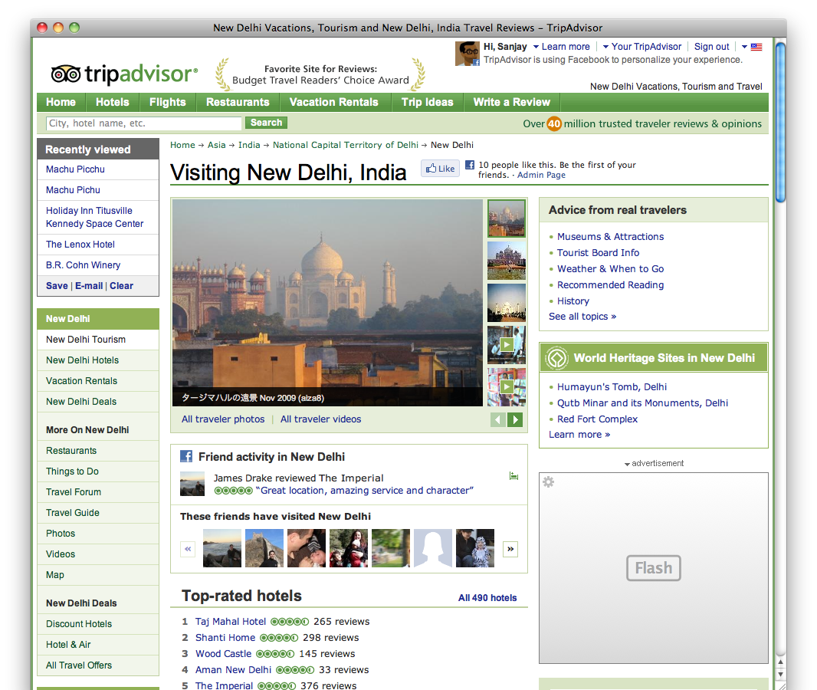
Instant Personalization: Other Pages
Notes:
On a page that he geo-specific content, we can narrow this down to just those reviews that are relevant to that location.
Taking a step back, the moment you arrive on the site, we’ve found and presented those bits of information that are most relevant to you.

Slide 14
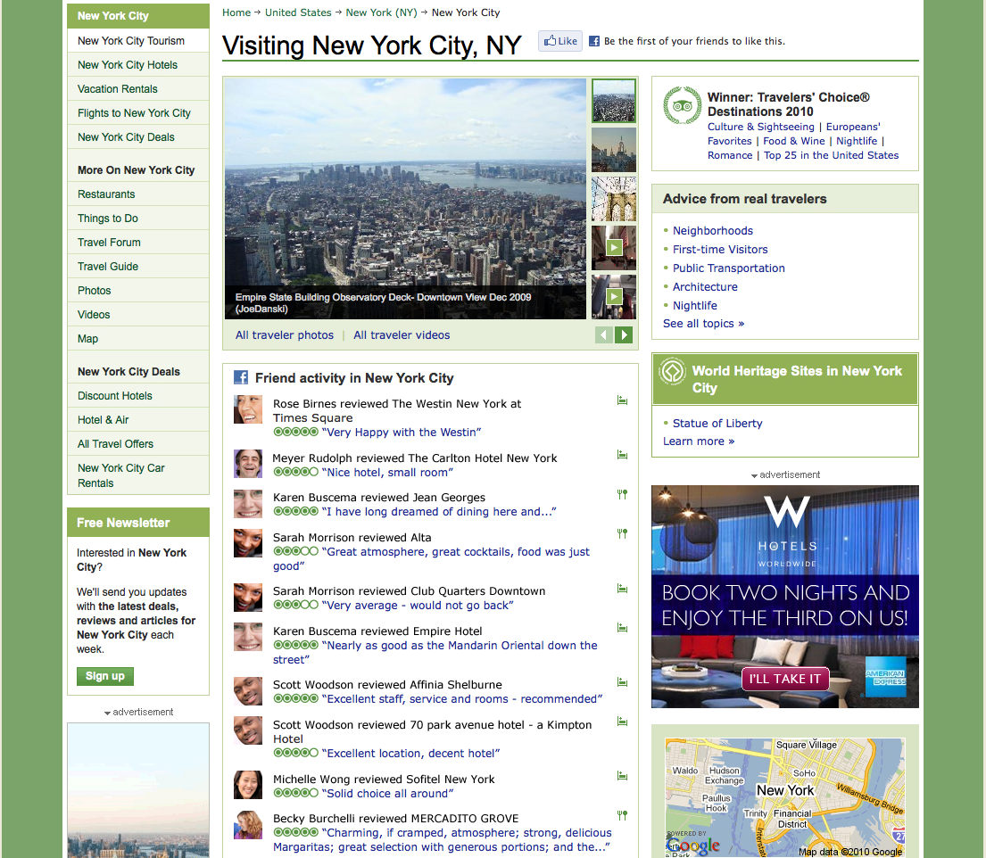
Notes:
Travelers can also visit a destination’s tourism page on TripAdvisor to uncover all the valuable, insightful comments written by people they know. And if travelers are researching a particular hotel, restaurant, or attraction, they will first see reviews written by their friends about that place.

Slide 15
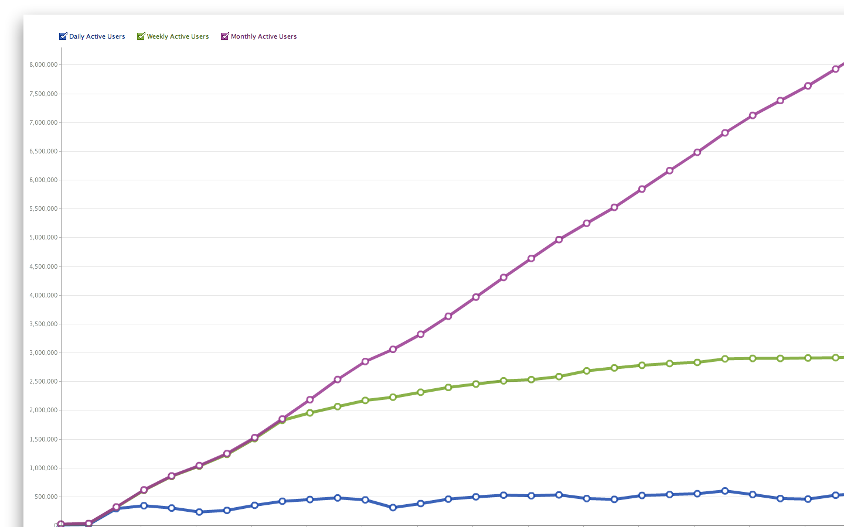
Up and to the right!
Over 10M/mo
For those users, we see:
  Decrease in bounce
  Increase in page views
  Increase in commerce
Minimal negative feedback
  < 1% opt-out
  Few complaints on forums
Notes:
Consistent growth in usage of IP

Slide 16
Press
“People are accustomed to asking friends for travel suggestions and advice, making TripAdvisor a wise choice for the expansion of the Instant Personalization program”
  InsideFacebook.com
“…today's addition of TripAdvisor brings friends' recommendations and opinions to a realm where friends really do matter - travel.”
  Read/Write web
Notes:
- Optout means that ~20% of our traffic sees this behaviour

Slide 17
Overview
Intro to TripAdvisor
Intro to
Instant Personalization
The Rollercoaster +
Three equations
Notes:
In today’s online and social world, travelers share comments that are rapidly and readily accessible to the public. What someone says about your property has farther reach – and potentially longer lasting effects -- than ever before.
Review sites are the hub of travelers’ sharing activity, and a top resource when they’re forming opinions. In their June study on Social Media in Travel, PhoCusWright states that travel review sites are one of the most influential forces for travelers during the shopping process. In an MSNBC poll from October, 86% of respondents said they rely on feedback from TripAdvisor and other review sites when making travel plans.
Minding your reputation on these sites is a critical part of marketing and operations for today’s hotels.

Slide 18
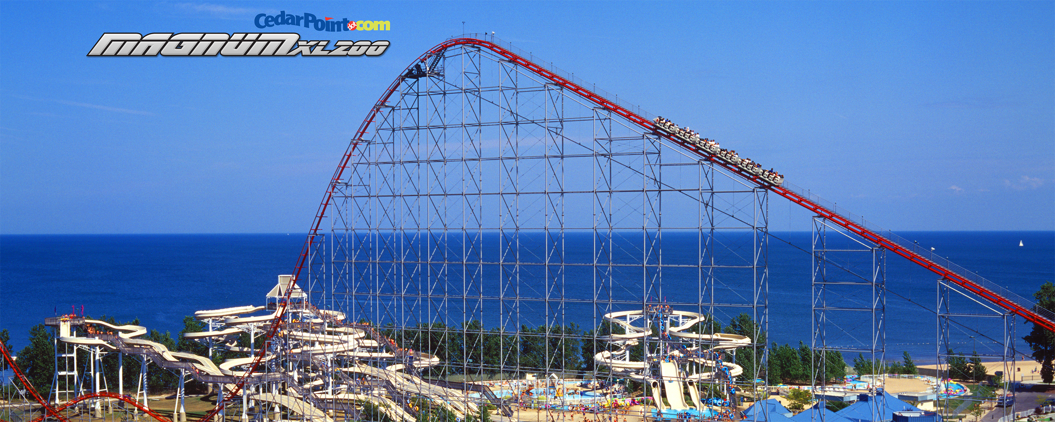
Initial Thoughts
Notes:
Consistent growth in usage of IP

Slide 19
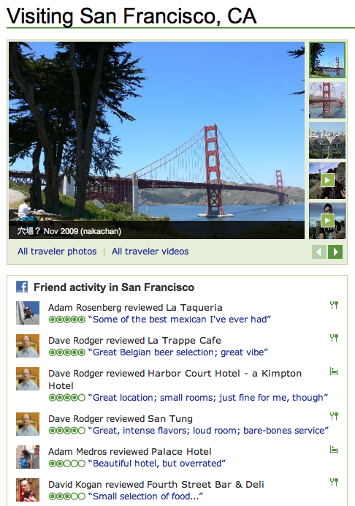
Initial Thoughts
Excitement over being the an IP partner
We have 40M reviews!
Build an engaging interface
Notes:
Consistent growth in usage of IP

Slide 20
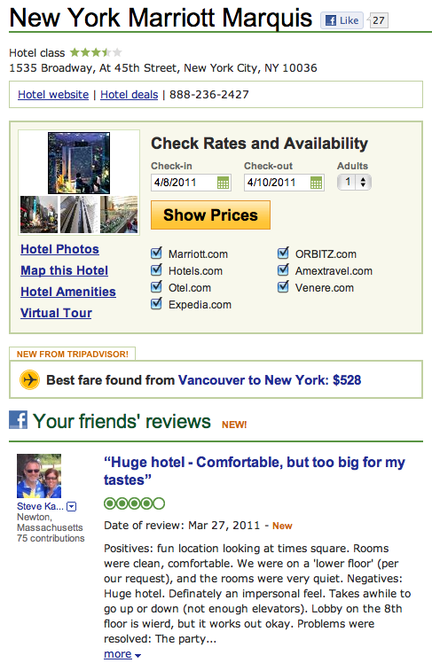
Property Reviews
Notes:
Consistent growth in usage of IP

Slide 21
Reality
How many reviews can we actually show
  Privacy Policy
  Are your friends members of TripAdvisor?
  How of your friends have written reviews?
The Internet is a big, lonely place
Notes:
Consistent growth in usage of IP

Slide 22
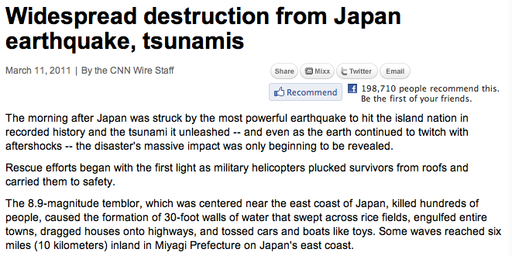

Lonely
Notes:
Consistent growth in usage of IP

Slide 23
Equation #1
Your Users
Internet
≅
0
Notes:
Consistent growth in usage of IP

Slide 24
Equation #1
Your Content
Internet
≅
0
Notes:
Consistent growth in usage of IP

Slide 25
The Drop
Notes:
Consistent growth in usage of IP

Slide 26
Hard UGC Numbers
Of 100 visitors
10 will become members
1 will generate content
Facebook users have ~200 friends
~2 of your friends have contributed content
Notes:
Consistent growth in usage of IP

Slide 27
Personalization Pyramid
Property
Reviews
Geo
Reviews
Reviews
?
Clickstream
Notes:
Consistent growth in usage of IP

Slide 28
Property Reviews
Notes:
Consistent growth in usage of IP

Slide 29
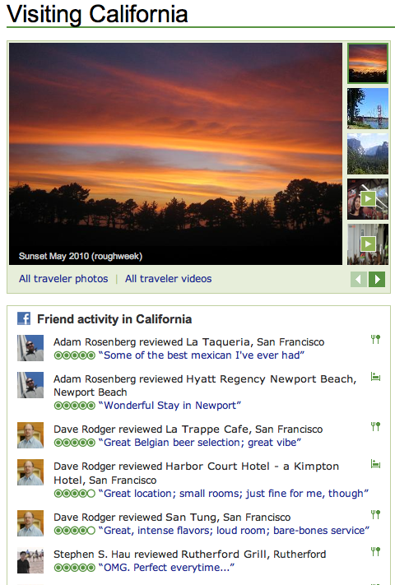
Geographic Reviews
Notes:
Consistent growth in usage of IP

Slide 30
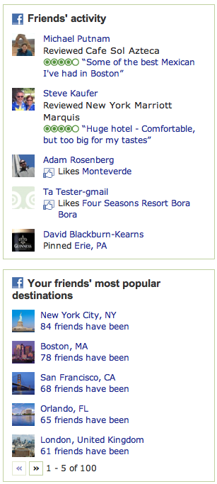
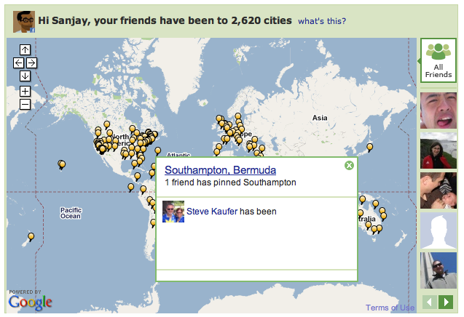
Make Every Review Count
Notes:
Consistent growth in usage of IP

Slide 31
Stretching Content
“
I feel... thin. Sort of stretched, like... butter scraped over too much bread.
- Bilbo Baggins to Gandalf
“

Slide 32
CTR still matters
10%
Property
Reviews
5%
Geo
Reviews
×
1%
Reviews
Clickstream
Notes:
Consistent growth in usage of IP

Slide 33
Equation #2
Engagement
∝
(Content) × (Relevance)
Notes:
Consistent growth in usage of IP

Slide 34
Personalization Pyramid
Property
Reviews
Geo
Reviews
Reviews
?
Clickstream
Notes:
Consistent growth in usage of IP

Slide 35
What Next?
Get
More
Content
Notes:
Consistent growth in usage of IP

Slide 36
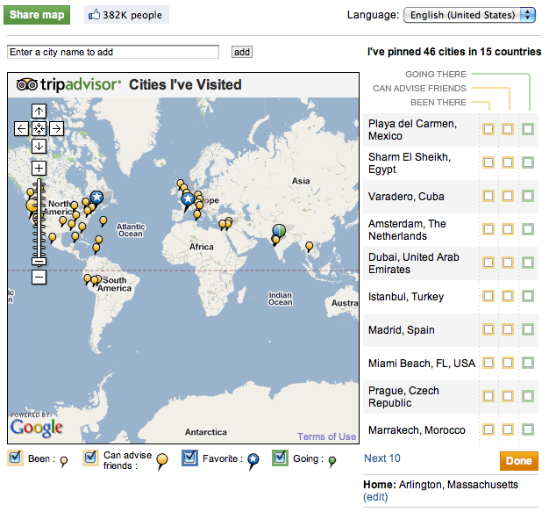
Cities I’ve Visited
Facebook application built in 2007 as part of the social app landgrab
Notes:
Consistent growth in usage of IP

Slide 37
CIV stats
25M+ users
~ 60 pins / user
~ 1.4B pins
+ “profile” pins
Users were notified that pins would be shown to friends
Notes:
Consistent growth in usage of IP

Slide 38
Better CIV numbers
Of 500M Facebook users
5% have used CIV
Facebook users have ~200 friends
~ 300 pins in CIV
+ (100 hometown pins)
+ (100 current_city pins)
~ 500 pins worth of social footprint
Notes:
Consistent growth in usage of IP

Slide 39
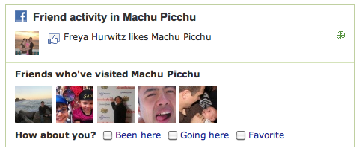
Cities I’ve Visited
Minimal content
Jumping off point for a conversation
Notes:
Consistent growth in usage of IP

Slide 40
Equation #3
(weak content)
×
(your friends)
=
(good content)
Notes:
Consistent growth in usage of IP

Slide 41
Lessons
Don’t optimize for the top of the pyramid
Figure out how to stretch your data
Find an ethical source of additional data
Notes:
Consistent growth in usage of IP

Slide 42
Hiring
Like this stuff?
Come work with me!
(please)
Notes:
Consistent growth in usage of IP

